Slide 1
Software Product Line Analysis Techniques
Ramy Shahin
Qualifying Oral - March 19th 2018

Slide 2
Definitions
Software Product Line (SPL) is a set of similar software products built from a common set of artifacts (e.g., design/specification models, code constructs, test cases, etc...).
Feature is an externally visible property, aspect or quality of a software system.
Feature Model (FM) (also knows as Variability Model (VM)) is a specification of the valid combinations of features in an SPL. This is typically expressed as a Boolean formula over features.
Feature Diagram (FD) is a hierarchical graphical representation of a Feature Model, where a non-root feature depends on its parent.

Slide 3
Software Analyses
What if our software artifacts come from an SPL?
Model(LTS) + Property(TL)
Source code/binary
Software Artifacts
Source code (AST/CFG)
Model Checker
Type Checker
Analysis
Symbolic Execution Engine
Test cases
Check/Counter Example
Check/TypeError
Useful Info
Example: Symbolic Execution Test Generator
Example: Type Checker
Example: Model Checker

Slide 4
Seven Papers
Paper | Analysis Category | Limitations
Apel et al. | Model Checking | Generative SPLs only
Liebig et al. | Static Analysis | Hand-crafted analyses
Midtgaard et al. | Abstract Interpretation | Systematic but not automated
Kästner et al. | Type Checking | Limited source code variability
Gazzillo and Grimm | Parsing (syntax checking) | Fully hand-crafted
Bodden et al. | Data-flow Analysis | IFDS analyses only
Classen et al. | Model Checking | Hand-crafted
Research Goal: To address the limitations (in particular, to automate lifting)

Slide 5

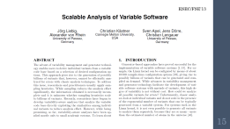
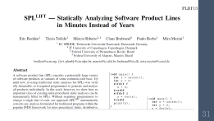

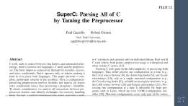
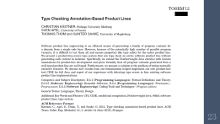


Slide 6

ICSE’13

Slide 7
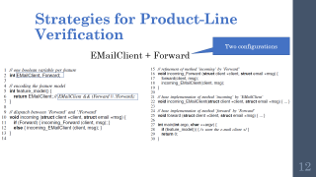
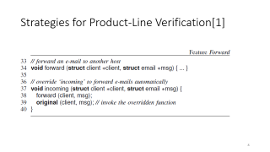
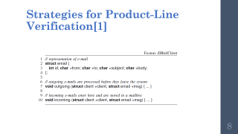
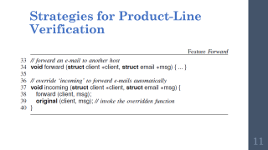
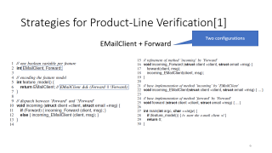
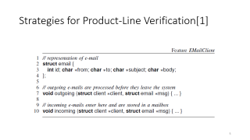
Strategies for Product-Line Verification
Generative SPL

Slide 8
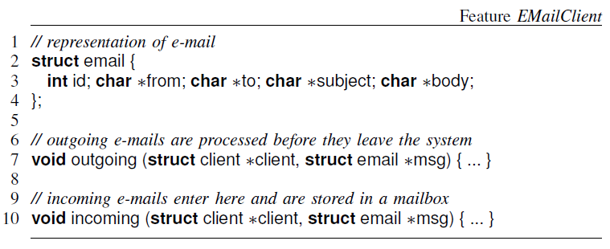
Strategies for Product-Line Verification[1]

Slide 9
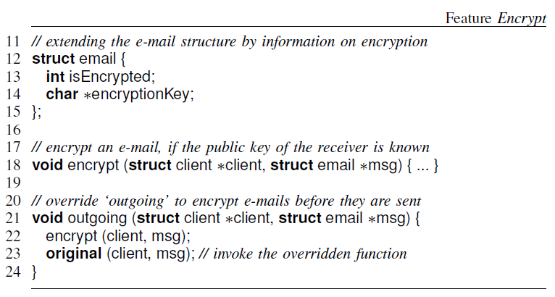
Strategies for Product-Line Verification
Notes:
ICSE’13 – Sven Apel et al. – University of Passau, Germany
Product-based, Sample-based and Family-based strategies

Slide 10
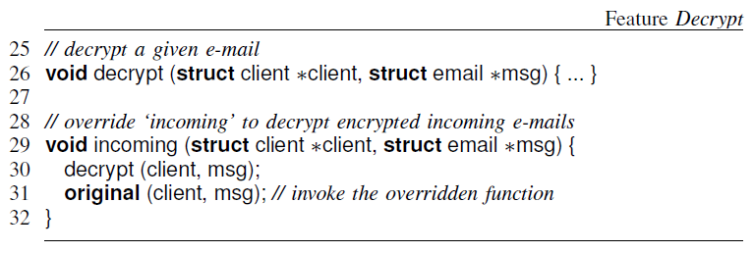
Strategies for Product-Line Verification
Notes:
ICSE’13 – Sven Apel et al. – University of Passau, Germany
Product-based, Sample-based and Family-based strategies

Slide 11
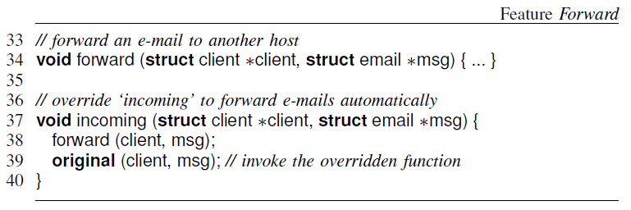
Strategies for Product-Line Verification
Notes:
ICSE’13 – Sven Apel et al. – University of Passau, Germany
Product-based, Sample-based and Family-based strategies

Slide 12
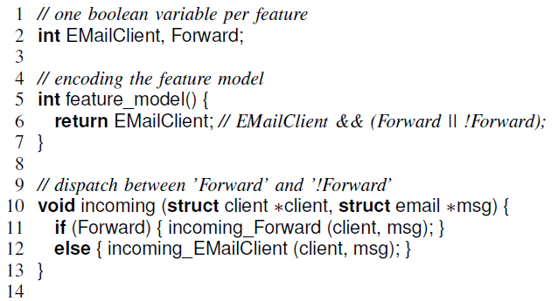
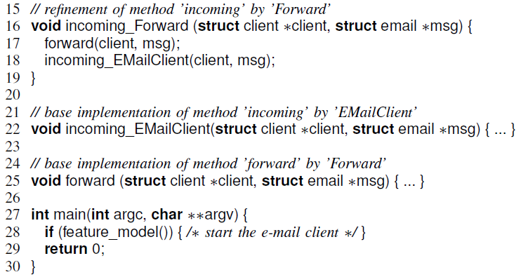
Strategies for Product-Line Verification
Two configurations
EMailClient + Forward
Notes:
Aspect weaving
Boolean variable per feature
Feature model predicate
Incoming dispatch function

Slide 13
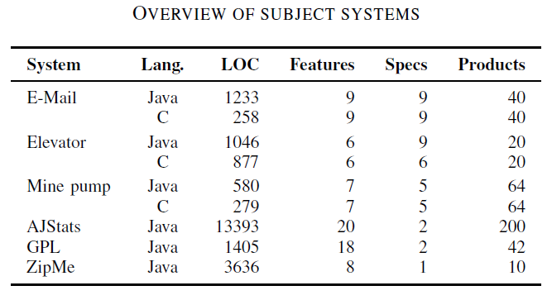
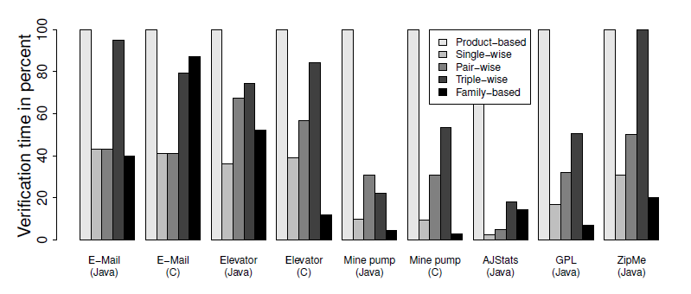
Strategies for Product-Line Verification[1]
Notes:
Evaluation: small systems (LOC, features, specifications and # of products)
CPAChecker for C code, Java Pathfinder for Java
Product-based is the baseline
Sampling does not find all defects
In some cases family-based outperform sampling

Slide 14
Strategies for Product-Line Verification
Compares product-based, sampling-based and family-based strategies
Uses existing model checkers (CPAChecker and Java Pathfinder) as is
Applicable only to generative product lines
Only supports very basic forms of variability
Generates a new function per configuration
Evaluates only single-wise, pair-wise and triple-wise sampling
Notes:
Evaluation: small systems (LOC, features, specifications and # of products)
CPAChecker for C code, Java Pathfinder for Java
Product-based is the baseline
Sampling does not find all defects
In some cases family-based outperform sampling

Slide 15
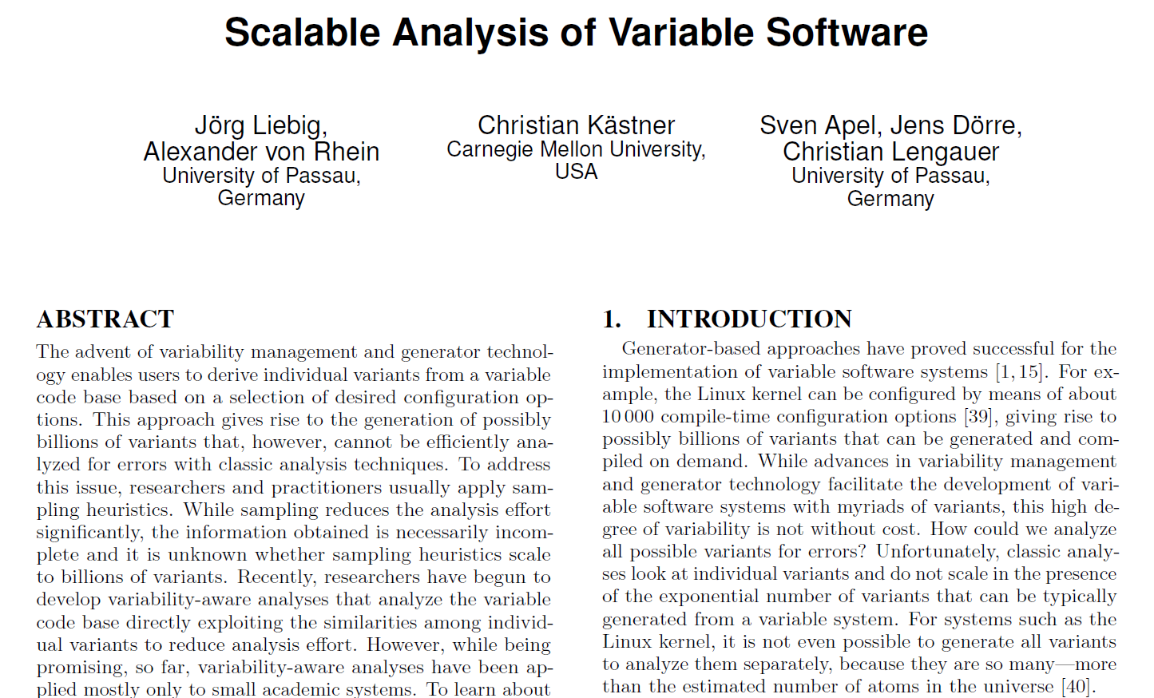
ESEC/FSE’13

Slide 16
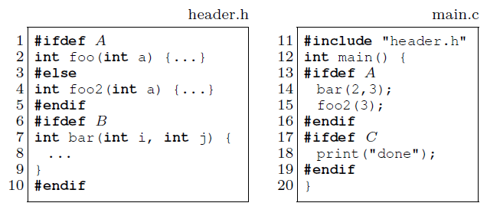
Scalable Analysis of Variable Software
Sampling Strategies:
Single-conf (e.g. {B,C})
Random
Code-coverage (e.g. {}, {A,B,C})
Pair-wise ({}, {A,B}, {B,C}, {A,C})
Annotative SPL (3 optional features)

Slide 17
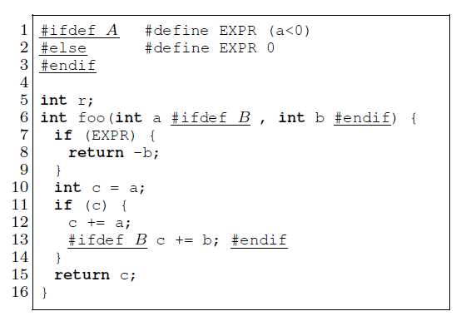
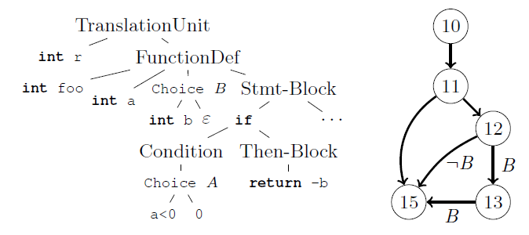
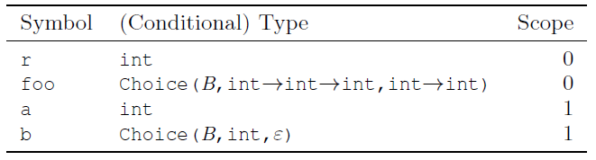
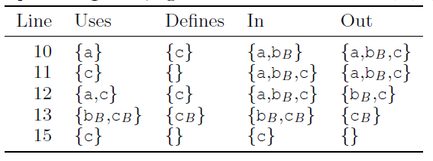
Scalable Analysis of Variable Software

Slide 18
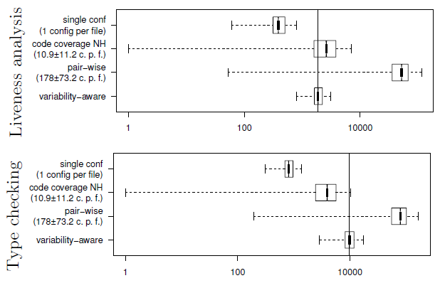
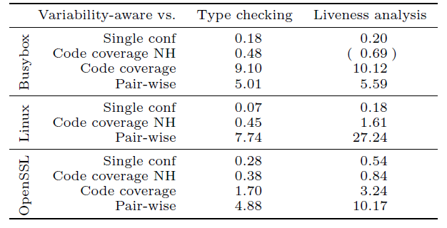
Scalable Analysis of Variable Software

Slide 19

SoCP’15

Slide 20
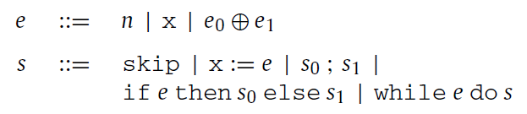
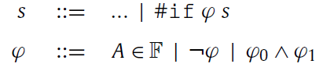
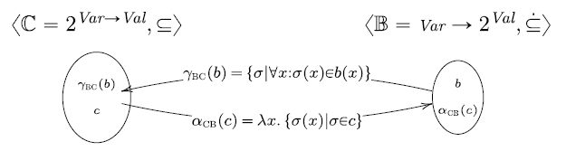
Variability-Aware Abstract Interpretation
Imperative language (annotative)
Semantics in terms of (Variable, Value) stores

Slide 21
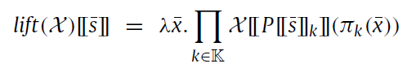
Variability-Aware Abstract Interpretation
Lifting combinator (a tuple of values, one per configuration):
Optimization: value sharing (shorter tuples)
Lossy optimization: variability abstraction
Compositionality of Galois connections
Minimum abstraction: fully preserves variability
Maximum abstraction: map all configurations into one

Slide 22
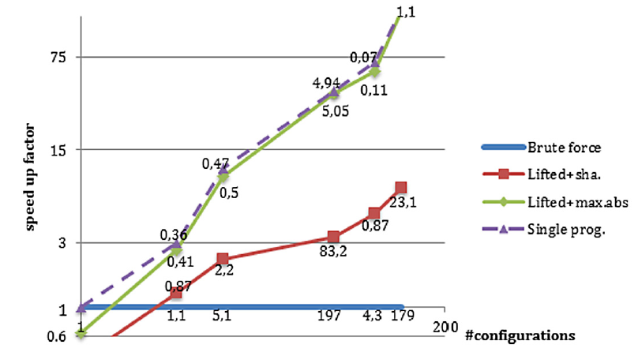
Variability-Aware Abstract Interpretation

Slide 23

TOSEM’12

Slide 24
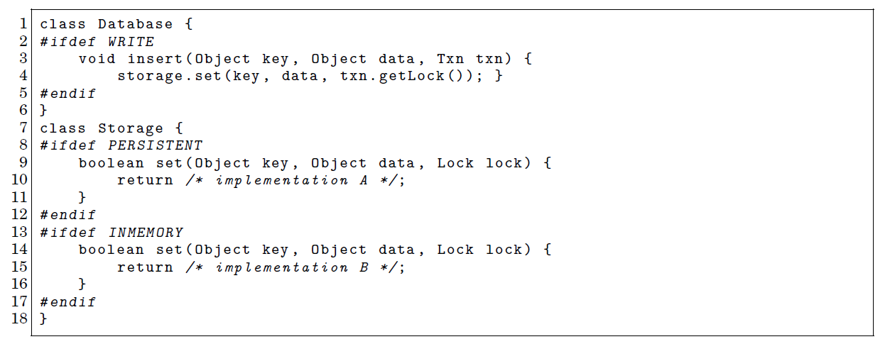
Product Line Type Checking

Slide 25
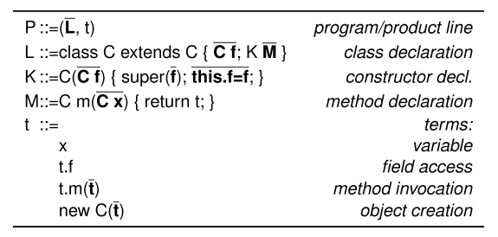
Product Line Type Checking
Colored Featherweight Java (CFJ) (annotative – limited)
Goals:
Product generation preserves typing
Backward compatibility (extends the Java Type System)
Type Checking: reachability rules (target reachable from reference)

Slide 26
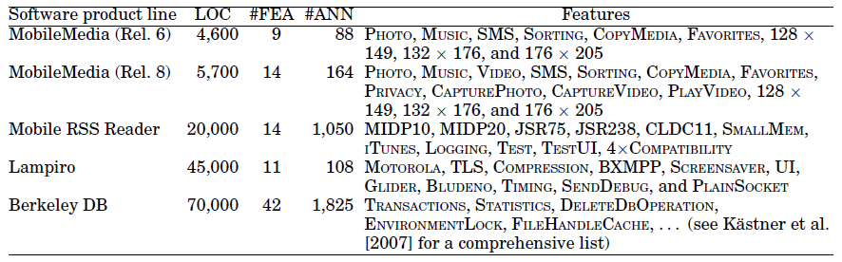
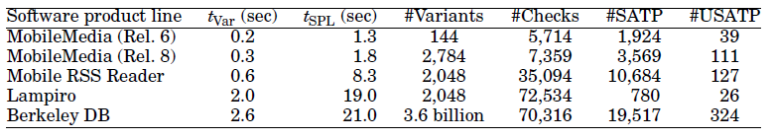
Product Line Type Checking

Slide 27
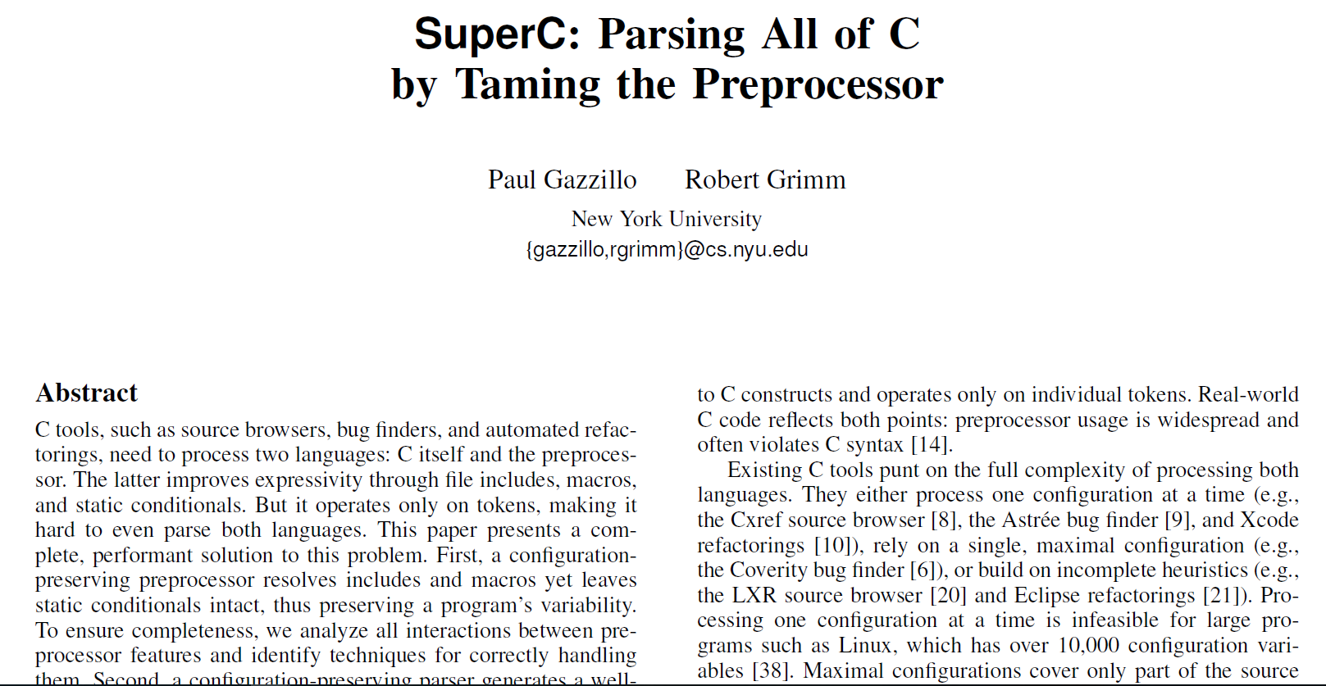
PLDI’12

Slide 28
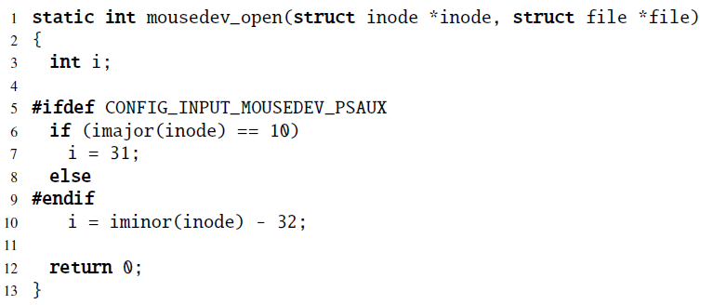
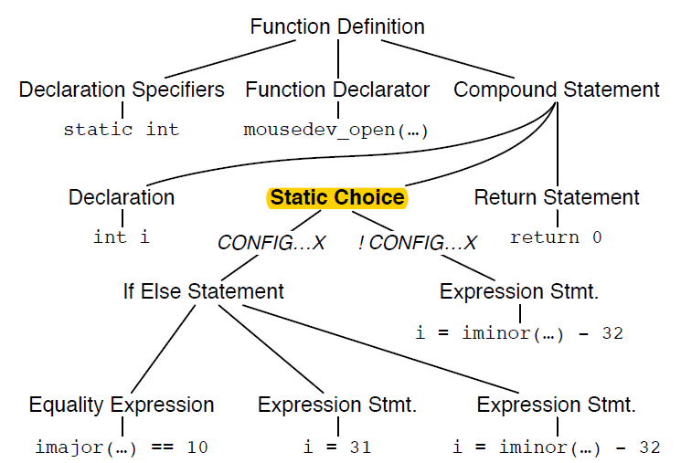
SuperC

Slide 29
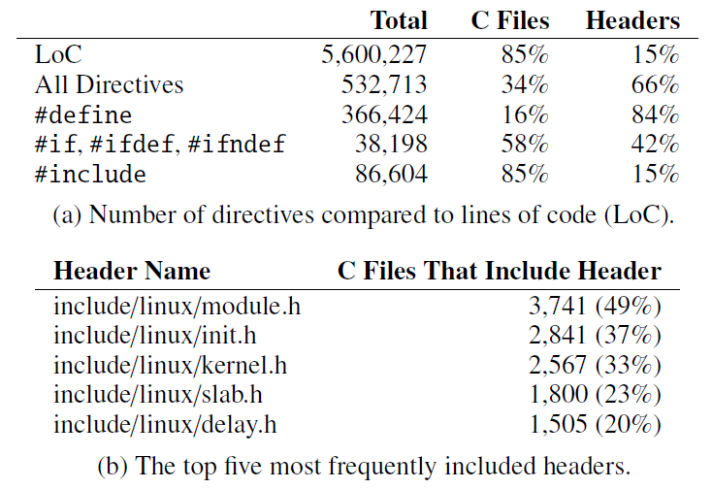
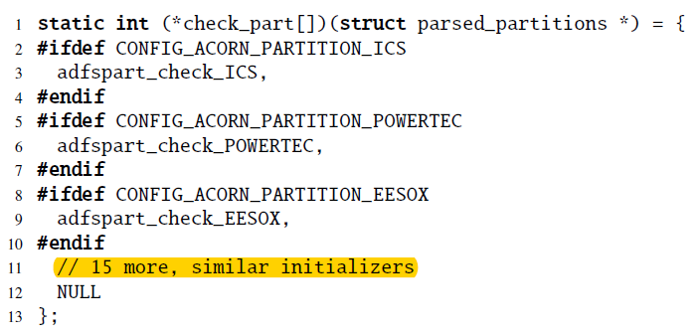
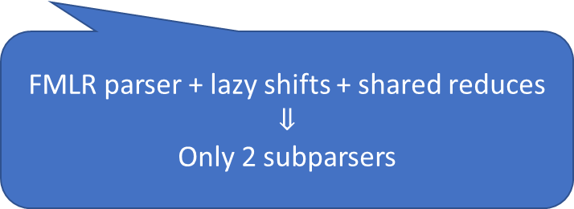

SuperC
block/partitions/check.c:
$2^{18}$ unique configurations
FMLR parser + lazy shifts + shared reduces
$$⇓$$
Only 2 subparsers

Slide 30
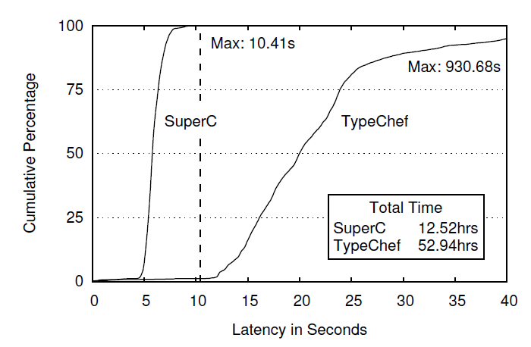
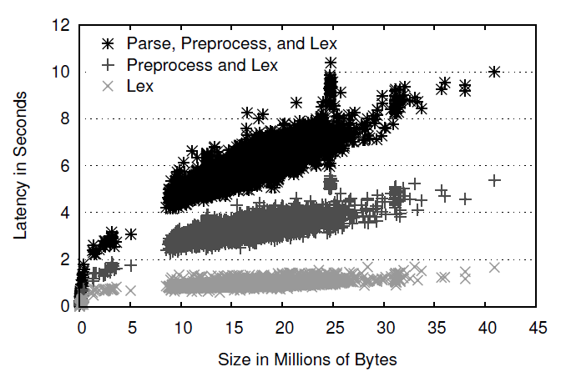
SuperC

Slide 31
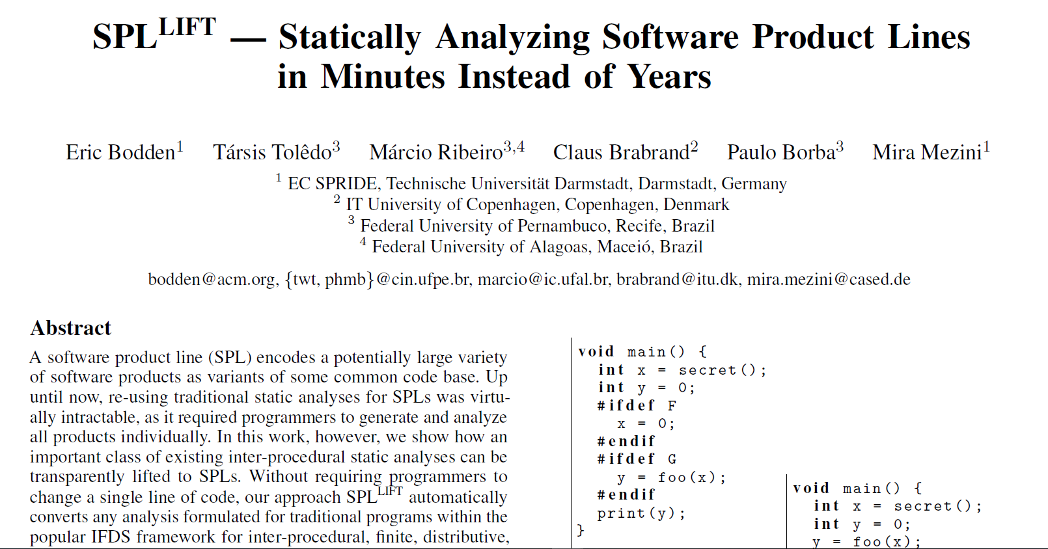
PLDI’13

Slide 32
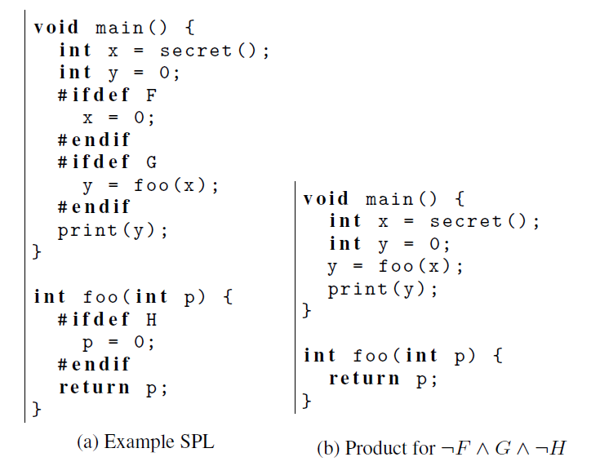
SPL^{LIFT}
Secret is leaked!!

Slide 33
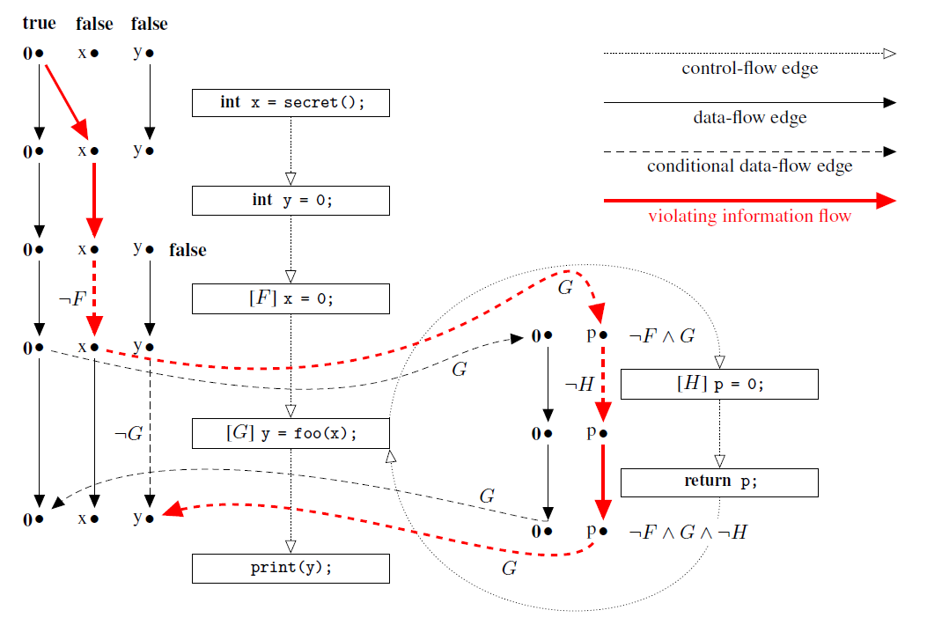
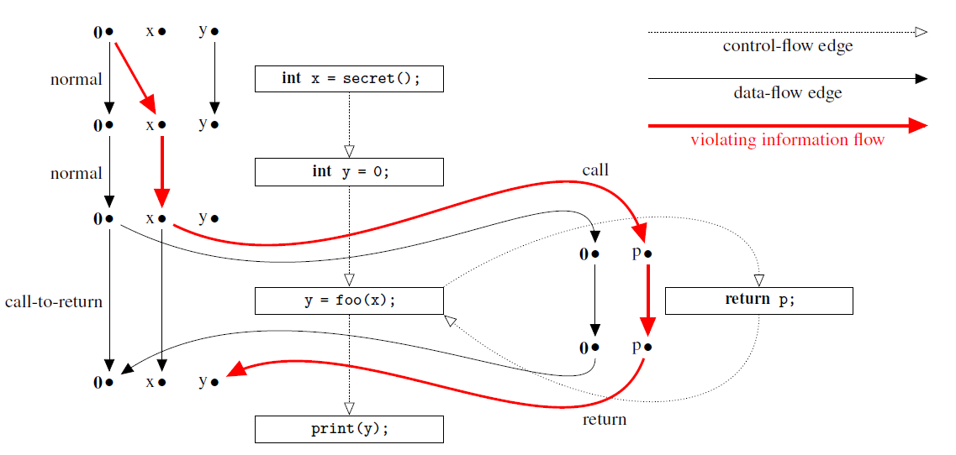
SPL^{LIFT}

Slide 34
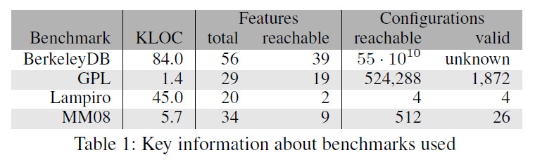
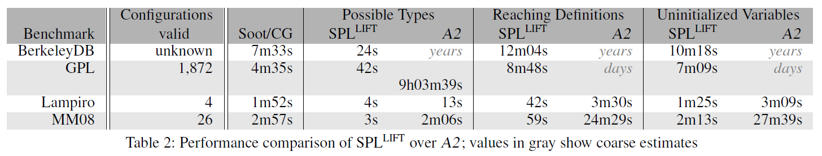
SPL^{LIFT}

Slide 35

TSE’13

Slide 36
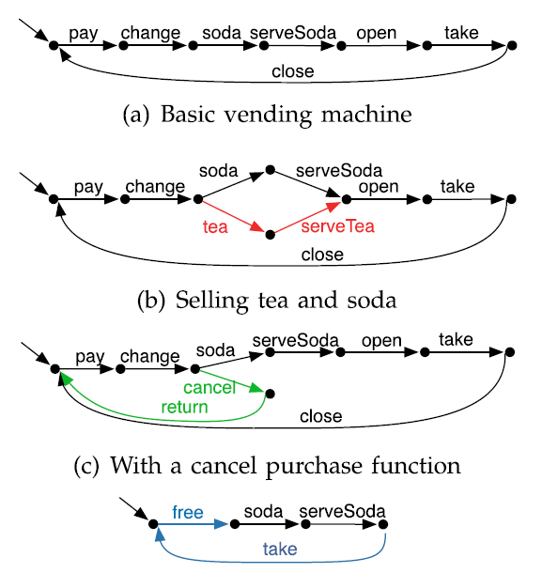


Featured Transition Systems

Slide 37

Featured Transition Systems
Feature LTL (fLTL) – LTL expressions enriched with feature expressions
fPromela
SNIP model checker

Slide 38


Featured Transition Systems

Slide 39
Can we automatically lift analyses to SPLs?

Slide 40

Typed Lambda Calculus
Terms:
Values and variables: 1 : Int, true : Bool, x : Int
Lambda abstractions: $λx. λy. x+y$ : Int -> Int -> Int
Lambda application: $\left(λx. λy. x+y\right) 5 8$ : Int
Computationally equivalent to Turing Machines and all Turing-complete languages
Other programming constructs built on top

Slide 41

Lifting Basic Types
F = {A,B}
x = [(1,A), (-2,$¬A∧B$), (3, $¬A∧¬B$)] x : Lifted Int
y = [(5, $A∧¬B$), (4,B), (-3, $¬A∧¬B$)] y : Lifted Int
z = [(“hello”, True)] z : Lifted String
For any type t:
type Variant t = [(t, PresenceCondition)]
Disjointness Invariant:
Given a lifted value $v=\left[\left(v_{1},pc_{1}\right), …\left(v_{n}, pc_{n}\right)\right]$, $∀i≠j,$unsat($pc_{i}∧pc_{j}$)

Slide 42
Lifting Values
lift :: PresenceCondition -> t -> Variant t
lift pc x = [(x, pc)]
Example: lift True 7 => [(7, True)]
liftT :: t -> Variant t
liftT x = lift True x

Slide 43

Lifting Unary Functions
abs (-3) => 3
x = [(1,A),(-2,$¬A∧B$),(3, $¬A∧¬B$)]
liftedAbs = liftT abs => [(abs, True)]
apply liftedAbs x => [(1,A), (2,$¬A∧B$), (3, $¬A∧¬B$)]
apply :: Variant (a -> b) -> Variant a -> Variant b
apply fn x = [ (fnVal xVal, conj [fnPC,xPC])
| (fnVal,fnPC) <- fn,
(xVal,xPC) <- x,
sat(conj[fnPC,aPC])]

Slide 44




Lifting Binary Functions
F = {A,B}
x = [(1,A),(-2,$¬A∧B$),(3, $¬A∧¬B$)]
y = [(5, $A∧¬B$),(4,B),(-3, $¬A∧¬B$)]
x + y => ??
liftedPlus = liftT (+) => [((+), True)]
liftedPlus :: Variant (Int -> Int -> Int)
apply liftedPlus x => [(+ 1, A), (+ -2, $¬A∧B$), (+ 3, $¬A∧¬B$)]
apply (apply liftedPlus x) y =>
[(+ 1 5, A $∧A∧¬B$), (+ -2 5, $¬A∧B∧$ $A∧¬B$), (+ 3 5, $¬A∧¬B$ $∧A∧¬B$),
(+ 1 4, A $∧$B), (+ -2 4, $¬A∧B∧\text{B}$), (+ 3 4, $¬A∧¬B∧\text{B}$), (+ 1 -3, A $∧¬A∧¬B$), (+ -2 -3, $¬A∧B∧$ $¬A∧¬B$), (+ 3 -3, $¬A∧¬B∧¬A∧¬B$)]
apply (apply liftedPlus x) y =>
[(+ 1 5, A $∧A∧¬B$), (+ -2 5, $¬A∧B∧$ $A∧¬B$), (+ 3 5, $¬A∧¬B$ $∧A∧¬B$),
(+ 1 4, A $∧$B), (+ -2 4, $¬A∧B∧\text{B}$), (+ 3 4, $¬A∧¬B∧\text{B}$), (+ 1 -3, A $∧¬A∧¬B$), (+ -2 -3, $¬A∧B∧$ $¬A∧¬B$), (+ 3 -3, $¬A∧¬B∧¬A∧¬B$)]
apply (apply liftedPlus x) y =>
[(6, $A∧¬B$), (5, A $∧$B), (2, $¬A∧B$), (0, $¬A∧¬B$)]

Slide 45
Lifting Functions of Other Arities
apply2 :: Lifted (a -> b -> c) -> Lifted a -> Lifted b -> Lifted c
apply2 fn a b = apply (apply fn a) b
apply3 :: Lifted (a -> b -> c -> d) -> Lifted a -> Lifted b -> Lifted c -> Lifted d
apply3 fn a b c = apply (apply2 fn a b) c
apply4 :: Lifted (a -> b -> c -> d -> e) ->
Lifted a -> Lifted b -> Lifted c -> Lifted d -> Lifted e
apply4 fn a b c d = apply (apply3 fn a b c) d
…

Slide 46
Lifting Conditional Expressions
cond :: Bool -> t -> t -> t
cond p a b = if p then a else b
condLifted :: Lifted Bool -> Lifted t -> Lifted t -> Lifted t
condLifted = apply3 (liftT cond)

Slide 47

Lifting Conditionals - Example
F = {A,B}
x = {(1,A),(2,$¬A∧B$),(3, $¬A∧¬B$)}
y = {(5, $A∧¬B$),(4,B),(3, $¬A∧¬B$)}
if (x == y) then (x + y) else (x - y)

Slide 48

Lifting Conditionals - Example
F = {A,B}
x = {(1,A),(2,$¬A∧B$),(3, $¬A∧¬B$)}
y = {(5, $A∧¬B$),(4,B),(3, $¬A∧¬B$)}
if (x == y) then (x + y) else (x - y)
liftedEq a b = apply2 (liftT (==)) a b
liftedPlus a b = apply2 (liftT (+)) a b
liftedMinus a b = apply2 (liftT (-)) a b
condLifted (liftedEq x y) (liftedPlus x y) (liftedMinus x y)

Slide 49
Challenges
Lifting building blocks
Data structures
Parsers
Optimizations
Lazy evaluation/lazy data structures
Value sharing
BDDs vs SAT solvers
Analyses written in a functional language (side-effect free)

Slide 50
Questions

